Slide 1
A Data Science Approach to NFL Pre-Snap Evaluation
Ranier Gran - DS 504 Final Project

Slide 2

Overview
Project Introduction
Data Description
Exploratory Data Analysis
Data Preprocessing
Prediction Methodology
Results & Conclusions
Future Work

Slide 3
Project Introduction

Slide 4
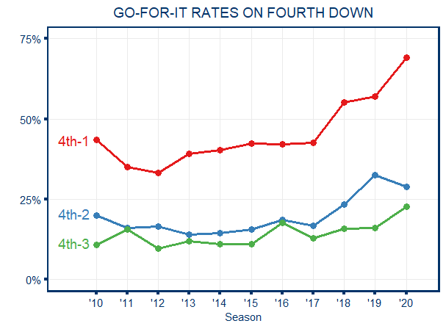
How to make better football decisions?
Data and analytics have been hot topics for the sports industry.
The NFL is a game of inches
Coaches and players will do nearly anything for incremental improvements to their team
The Bad: Filming Sidelines, Banging on Trash Cans
The Good: Data Driven Decisions
EX: With the help of analytics, teams have been attempting 4th down conversions at a much higher rate

Slide 5
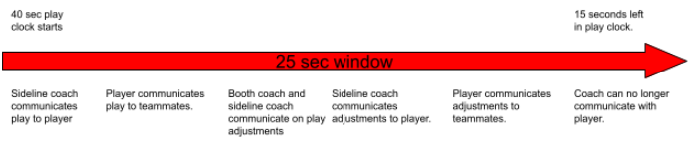
Opportunities to make in game adjustments fueled by data
Coaches are able to communicate with a headset to single player on offense and defense
With a limited play clock and window for communication, decisions and adjustments must be made fast
If we are able to predict a play’s performance with ML, we can make faster adjustments.

Slide 6
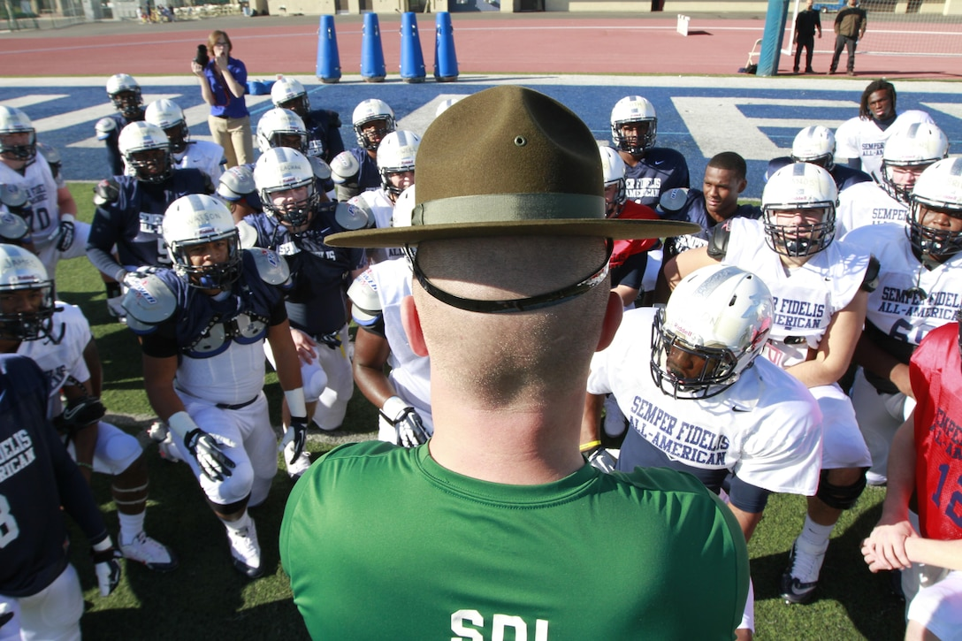
Other Data Driven Opportunities
Pre-Game Planning
Identify which types of coverages a team leans toward
Practice defensive looks opposing QB has performed worse against
Player Scouting
Learn player’s strengths and weaknesses to find the best players for your team
Exploit opposing player’s weaknesses more effectively

Slide 7
Data Description

Slide 8
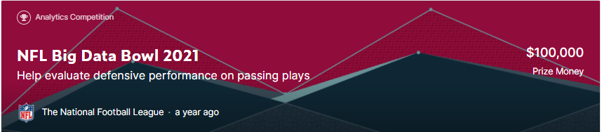
Data
For our analysis we used the Kaggle NFL Big Data Bowl 2021
https://www.kaggle.com/c/nfl-big-data-bowl-2021/data
4 sets of data tables
Games
Players
Plays
Tracking

Slide 9
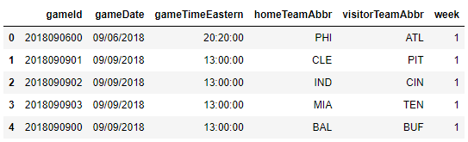
Games
Games data structure:
253 games
This will be a reference table only
Game time and week number could be used as additional information
Team abbreviations will be used for joins

Slide 10
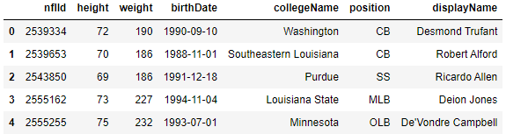
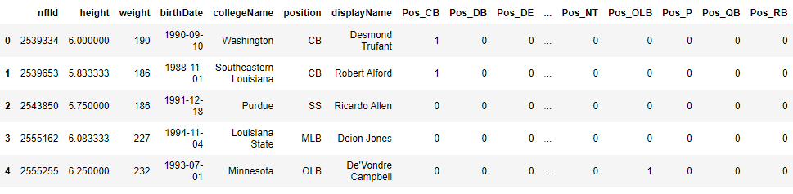
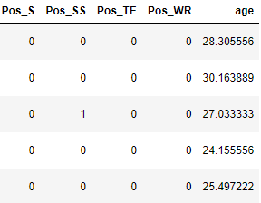
Players
Players initial data structure (7 columns, 1303 players):
Height had some string values (ex: “6-2”)
Birthdate had multiple formats (ex: YYYY-MM-DD vs MM/DD/YYYY)
collegeName and displayName will not be used
One-Hot-Encoded position
Updated Players data structure (29 columns):

Slide 11
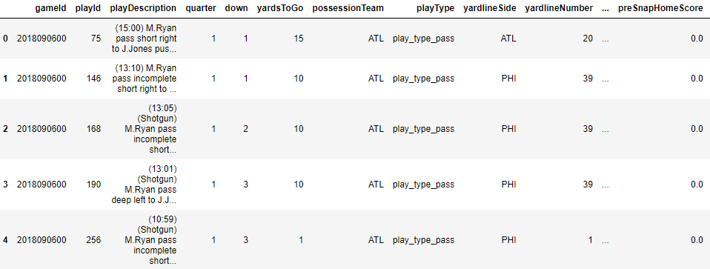
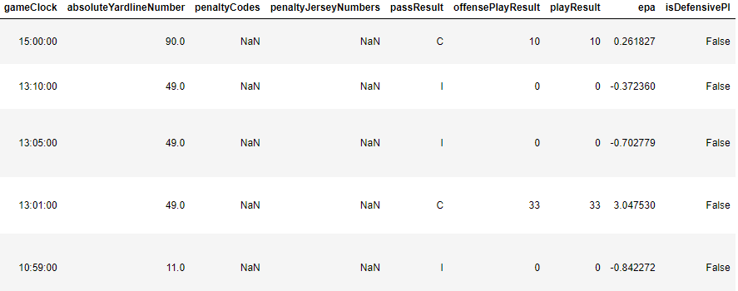
Plays
Plays initial data structure (27 columns, 19239 plays):
gameClock and quarter fields combined to measure time left in game
Personnel columns and offensive formation column one hot encoded

Slide 12
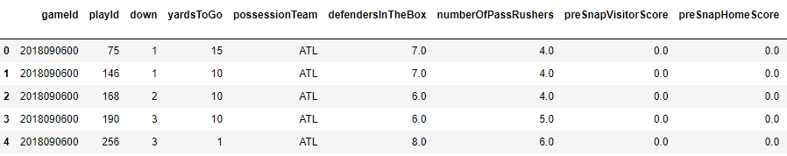
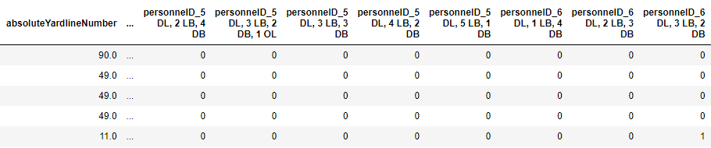
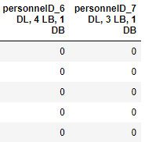
Plays cont.
Several columns from Plays table removed
Updated Plays data structure (135 columns):
Column Removed | Reason for Removal
playDescription | String too long and variable for one-hot-encoding. Information reveals play result. Impossible to know before play for prediction. (Target Leakage)
playType | Information reveals play result. Impossible to know before play for prediction. (Target Leakage)
yardlineSide | Covered by another variable (absoluteYardlineNumber)
yardlineNumber | Covered by another variable (absoluteYardlineNumber)
typeDropback | Impossible to know before play for prediction. (Target Leakage)
penaltyCodes | Information reveals play result. Impossible to know before play for prediction. (Target Leakage)
penaltyJerseyNumbers | Information reveals play result. Impossible to know before play for prediction. (Target Leakage)

Slide 13
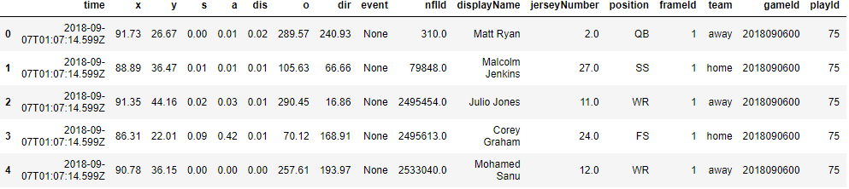
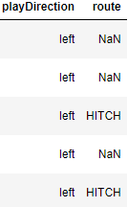
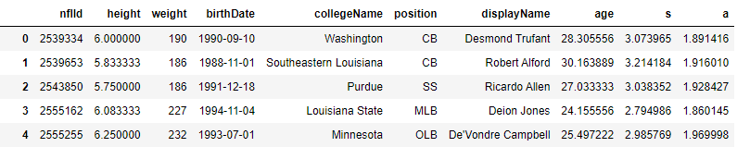
Tracking Data
Tracking initial data structure (20 columns, 18309388 time stamped tracking events):
Average player speed (s) and acceleration (a) calculated over all tracking data, joined to player table.

Slide 14
Exploratory Data Analysis

Slide 15
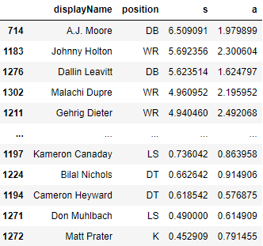
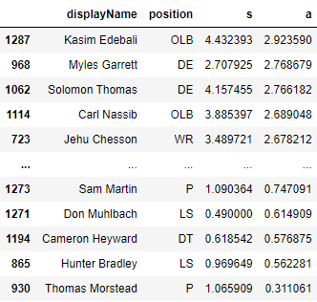
Player Scouting, who to target?
Players with highest speed are DBs and WRs (this makes sense!)
Players with lowest speed are Kickers and interior linemen (this also makes sense!)
Sorted by acceleration we see defensive ends coming off the edge like Myles Garrett.
Providing additional help on his side of the offensive line could help avoid QB pressures.

Slide 16
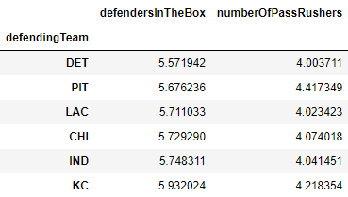
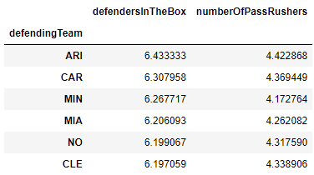
Team Scouting, how to attack?
Understanding how teams typically play defensively can improve how you attack them on offense.
Teams who stack the box like the Arizona Cardinals are susceptible to throws over the top but are harder to run the ball against.
Teams with less defenders in the box like the Detroit Lions can leave open cushions for short and intermediate pass plays but are more conservative against the deep ball.

Slide 17
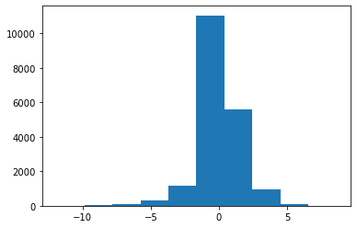
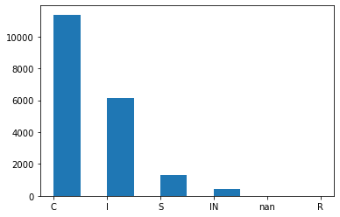
Advanced Analytics, What to predict?
Possible Target Variables Identified:
'passResult', 'offensePlayResult', 'playResult', 'epa', 'isDefensivePI'
In game, scoring is obviously key, focusing on epa (Expected Points Added) can allow us to judge how successful a play will be offensively or defensively.
From a classification standpoint, pass result could also be a reasonable target. Recognizing when a play would result in a catch (C), incomplete pass (I), sack (S), or interception (IN) before the snap could lead to important adjustments especially in clutch areas of the game.
Giving up a sack on 3rd down is much worse than throwing an incomplete pass
Play Result predictors could be used for post play predictions to help judge the impact after a play.

Slide 18
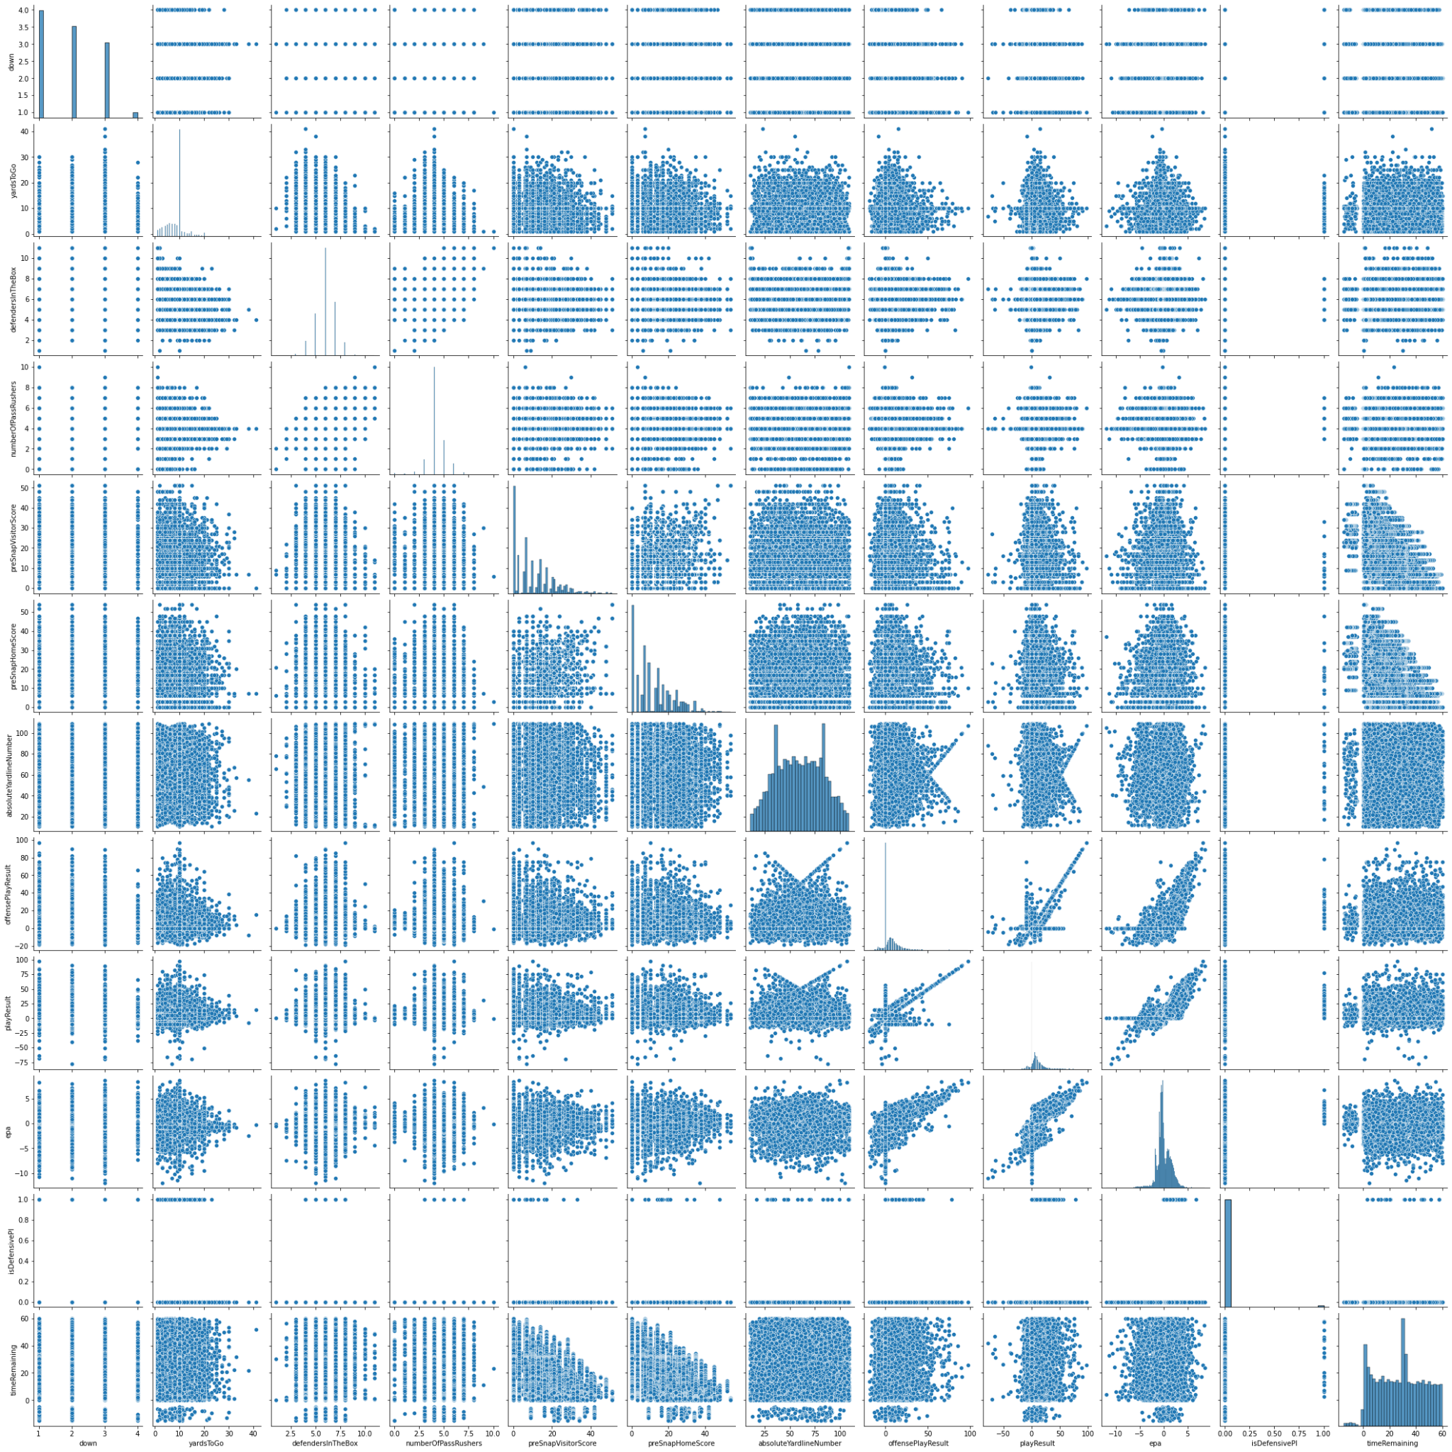
Variable Correlation, what leads to a big play?
Generated Pairwise plot of non-player, non-one-hot encoded variables:
'down',
'yardsToGo',
'defendersInTheBox',
'numberOfPassRushers',
'preSnapVisitorScore',
'preSnapHomeScore',
'absoluteYardlineNumber',
'passResult',
'offensePlayResult',
'playResult',
'epa',
'isDefensivePI',
'timeRemaining'
From this we can see that not many variables are correlated. Some of the target variables are correlated to one another.

Slide 19
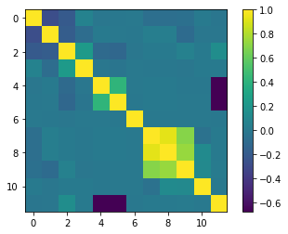
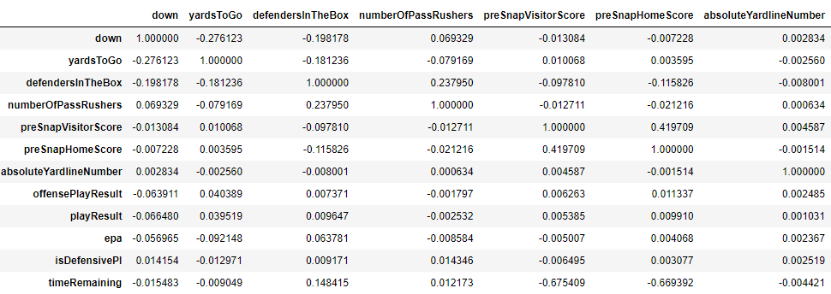
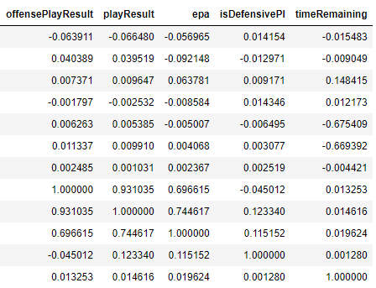
Variable Correlation cont.
Looking at these from a numerical perspective, we confirm that the only variables that really have correlation are the predictor variables.
EPA is driven by the pass result

Slide 20
Data Preprocessing

Slide 21
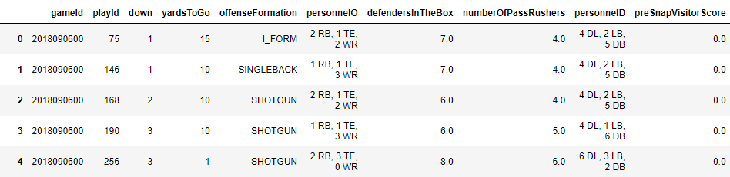
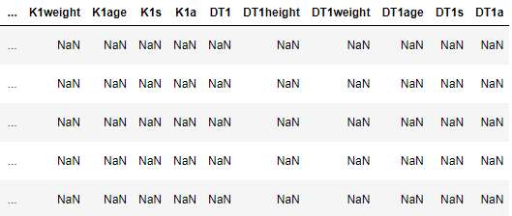
Full Data Structure
For each play, all players involved are gathered by position with their height, weight, age, speed, and acceleration.
Up to 22 players were tracked per play. (11 on defense, 11 on offense)
Positions not tracked on a given play were labeled NA and later imputed with 0’s
19239 plays, 145 columns

Slide 22
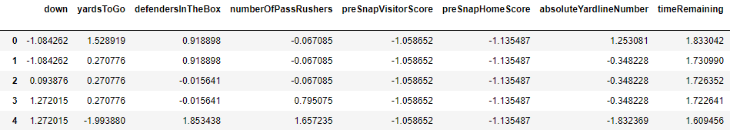
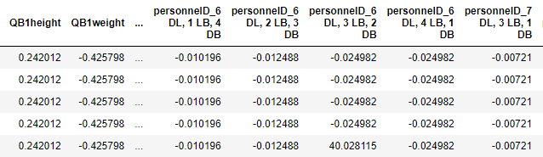
Final Full Data Structure
Categorical Variables are one hot encoded
Missing Values imputed with 0’s
All Variables are Z-transformed to normalize columns
Unnecessary columns are removed
gameId, playId
Predictor Variables are separated
19239 plays, 237 columns

Slide 23
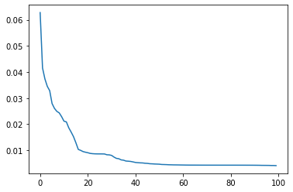
Dimension Reduction
With so many predictor columns we utilize PCA to reduce the dimensionality
PCA Scree Plot shows us we can use closer to 30 principle component predictors
Value of 35 selected to explain most of the variance in the data for modeling

Slide 24
Prediction Methodology
Four ways of Foresting

Slide 25
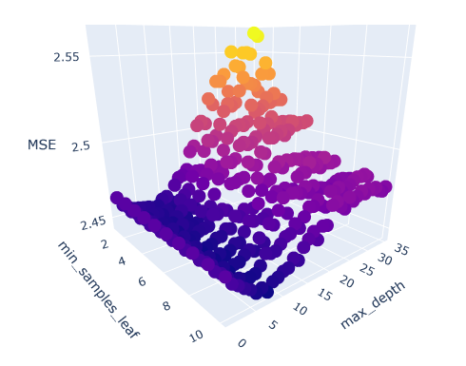
Only knowing pre-snap information, can we predict EPA?
Utilizing our Principle Component Dataset we train a random forest regression model.
Cross Validation:
Train:test split 66:33
Hyperparameter Tuning - min_samples_leaf, max_depth
Error Metric: Mean Squared Error (MSE)
The Baseline:
Null model (always predicting the mean EPA) 2.499 MSE
Best Model:
Model Improvement from Baseline: 2% Increase in Accuracy
min_samples_leaf | max_depth | Test MSE
8 | 7 | 2.446

Slide 26
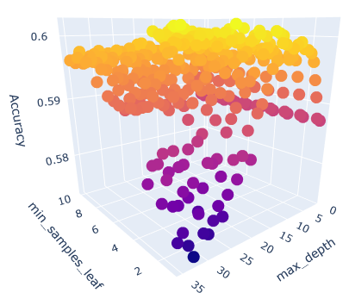
Only knowing pre-snap information, can we predict the pass result (C,I,S,INT)?
Utilizing our Principle Component Dataset we train a random forest classification model.
Cross Validation:
Train:test split 66:33
Hyperparameter Tuning - min_samples_leaf, max_depth
Error Metric: Accuracy
The Baseline:
Null model (always predicting a catch) 59.1% accuracy
Best Model:
Model Improvement from Baseline: 1.1% Increase in Accuracy
min_samples_leaf | max_depth | Test Accuracy
4 | 13 | 60.2%

Slide 27
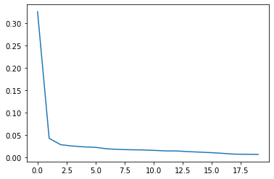
Knowing pre-snap information and play result, can we predict EPA?
This time including play result information we recalculate the PCA. This results in a lower amount of PC’s used to explain the variance: 7
Cross Validation:
Train:test split 66:33
Hyperparameter Tuning: kept fixed from previous regression
Error Metric: Mean Squared Error (MSE)
The Baseline:
Null model (always predicting the mean EPA) 2.499 MSE
Best Model:
Model Improvement from Baseline: 70% Increase in Accuracy
min_samples_leaf | max_depth | Test MSE
8 | 7 | 0.730
Variance Explained
Number of PCs

Slide 28
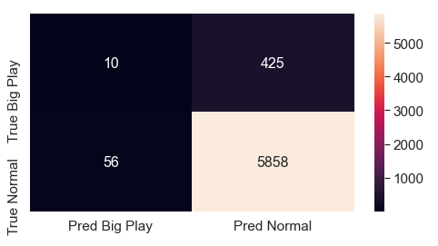
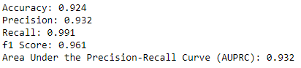
Big Plays are outliers, but important to defend, can we predict them?
Back to our original PCA data without play result, we train an Isolation Forest to identify outliers.
Big plays must be defined
EPA > 2 and absoluteYardlineNumber > 40
These are plays that start at midfield or further and result in an almost guaranteed field goal at minimum
Cross Validation:
Train:test split 66:33
Test Results:

Slide 29
Results and Conclusions
How do we make an impact on a team?

Slide 30
Comparing our models, what is helpful?
We began with a goal of predicting the play result with only pre-snap information.
Our Regression technique on EPA only provided a 2% improvement from the mean
Our Classification technique on Pass Result only provided a 1% improvement from predicting a Catch on every play
While the NFL is a game of inches, and these minimal improvements could be slightly helpful, they aren’t strong enough to push to make considerable change.
Model Type | min_samples_leaf | max_depth | Improvement from Baseline
Regression (EPA) | 8 | 7 | 2%
Classification (Pass Result) | 4 | 13 | 1.1%
Regression (EPA post play) | 8 | 7 | 70%

Slide 31
Comparing our models, what is helpful?
Next we looked at a post-play model. Understanding EPA after a play can change how a team might respond on the next play.
This model provided a 70% improvement in accuracy as compared to the mean
Using this model, if a defending team gave up a play with an exceptionally high predicted EPA, they might look to change their strategy on the next play, or in the next time they find themselves in a similar position on the field.
Model Type | min_samples_leaf | max_depth | Improvement from Baseline
Regression (EPA) | 8 | 7 | 2%
Classification (Pass Result) | 4 | 13 | 1.1%
Regression (EPA post play) | 8 | 7 | 70%

Slide 32
Comparing our models, what is helpful?
Finally we looked at an outlier detection model to identify big plays
This model’s accuracy is fairly high, however it does miss out on a considerable amount of big plays
However, stopping any big play can be game changing.
A model like this could be implemented in clutch situations to adjust a formation, change an assignment, or even call a timeout to stop the play from happening at all.
Many of the ones it does catch occur on 4th down and some are even trick plays like fake punts
(10:00) (Punt formation) K.Byard pass deep right to D.Cruikshank for 66 yards, TOUCHDOWN.
(4:12) C.Clark reported in as eligible. C.McCaffrey pass short right to C.Manhertz for 50 yards, TOUCHDOWN.

Slide 33
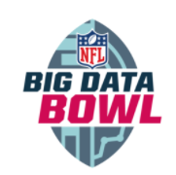
Conclusions
Predicting play results in the NFL is not an easy task. If it was, every team in the league would be implementing it and strategies would change drastically.
Modeling can provide some incremental gains and a 2% improvement in play recognition could mean the difference between winning and losing a game.
These models could be used by coaches as a supplement to their current strategies rather than a replacement
Post Play models could be useful in adjusting strategies to improve on the next play with 70% accuracy increases.
While only a small percentage of big plays can be predicted, stopping a single big play could change the tides of a game.
Implementing the outlier detection model would have limited risk while providing immediate impact

Slide 34
Future Work

Slide 35
Future Work
Test out other modeling techniques
Run with parallel processing to improve runtime
Project was completed using Python Jupyter Notebooks and local memory
Test model predicting on live games

Slide 36
References
Background information has been gathered from previous research as a part of humanities and arts capstone as well as other sources.
Capstone - Sports Analytics The Story Behind the Numbers: https://drive.google.com/file/d/13F2bQRG8Zz80xTZIVGL0ldU-rpSGrcgT/view?usp=sharing
Headset Rules: https://gethypedsports.com/do-football-players-have-speakers-microphones-in-their-helmet/#:~:text=There%20are%20a%20set%20of,what%20the%20coach%20is%20saying
4th down statistics: https://footballscoop.com/news/nfl-teams-going-for-it-on-fourth-down-more-often

Slide 37
Thank you! Please feel free to reach out with any questions, comments, or concerns!
rxgran@wpi.edu
raniergran@gmail.com

